Slide 1
Ontology-based data access
Gilles Falquet
Semantic Web Technologies

Slide 2
Principle and hypotheses
View datasets through an ontology, not through a database schema
Hypotheses/observations
the main bottleneck in data access is the complexity of the database schemas
the vocabulary of an ontology is more understandable than the table and column names

Slide 3
Reference
Kharlamov et al. (2016) Ontology Based Data Access in Statoil. Web Semantics: Science, Services and Agents on the World Wide Web 44 (2017) 3–36

Slide 4
Geological data at statoil
Exploration and Production Data Store (EPDS)
3000 tables and views
about 37,000 columns
naming conventions for schema elements, constraints, and the structure of EPDS’s schema are complex and considerable parts of it have limited or no documentation.
the major challenge with accessing EPDS is the schema complexity
Finding the right data is hard !

Slide 5
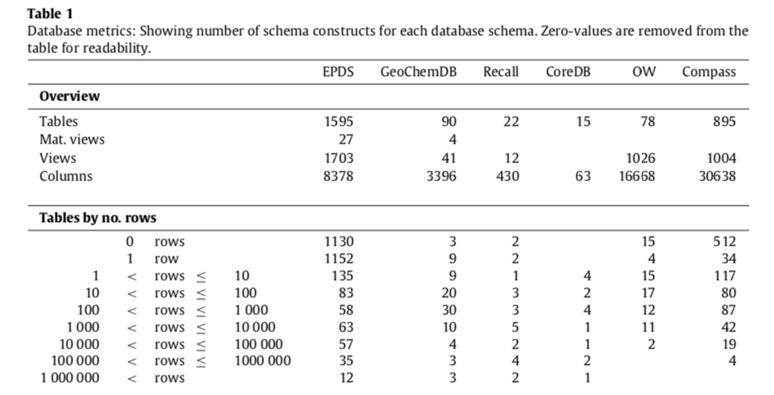

Slide 6
Access Points
Access points are typically based on materialized special purpose database views.
The process of making such view consists of the three ETL steps:
Extracting, Transforming, Loading data.
An SQL query for data extraction generated by the extraction tools may contain thousands of words and have 50–200 joins.
Building an ETL process consists of a myriad of data access and processing steps, many of which require deep knowledge of the data that is being processed and how it is represented.
IT staff become the de facto mediators between geologists and databases

Slide 7
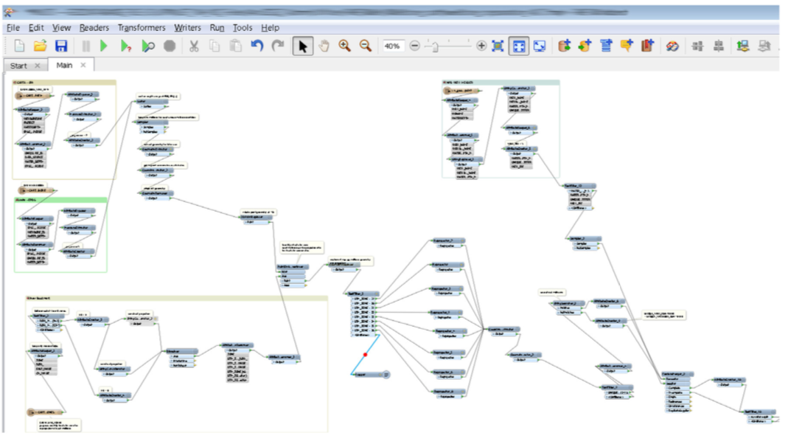
ETL process in FME

Slide 8
Ontology Based Data Access
Use a familiar vocabulary
Provide the user with access to the data store via the use of a domain specific vocabulary of classes and properties that the user is familiar with.
This vocabulary is related to the database schema via mappings
Technical details of the database schema are hidden from end-users.

Slide 9
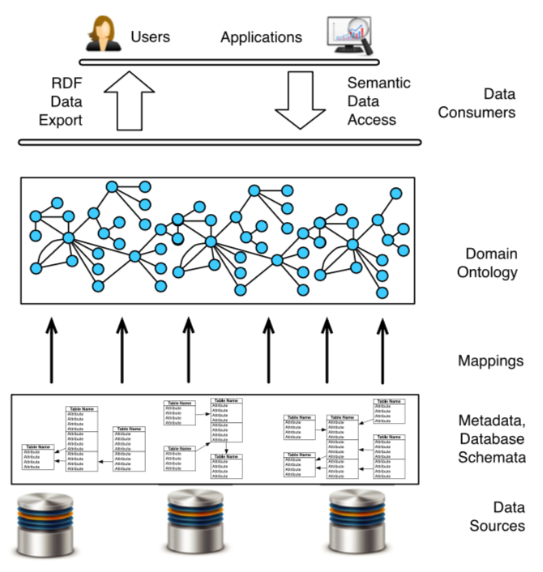
Abstraction

Slide 10
Principles
query over the domain vocabulary →
queries over the database schemas
executed over the data by DBMS.
the domain vocabulary enhanced with formal axioms → an ontology
exploit ontological axioms to enrich query answers with implicit information ⇒ ontological reasoning
data are treated under the Open World Assumption ⇒ can be incomplete w.r.t. to the ontology axioms.

Slide 11
Query Answer Enrichment
Enrichment of answers is done via logical reasoning:
User query Q over the domain vocabulary
→ rewriting →
New query over this vocabulary
logically equivalent to Q w.r.t. the ontology
"absorbs" a fragment of the ontology relevant for answering Q

Slide 12
Example
The data may state that the rock layers in the area surrounding the Ekofisk field are chalk, but not their age
The user asks for wellbores that penetrate rock from the Cretaceous era
Direct query: will not return the wellbores of Ekofisk
Rewritten query: will also ask for wellbores that penetrate chalk, and thus return the Ekofisk’s wellbores.
Using the knowledge Chalk has been formed in the Cretaaceous era

Slide 13
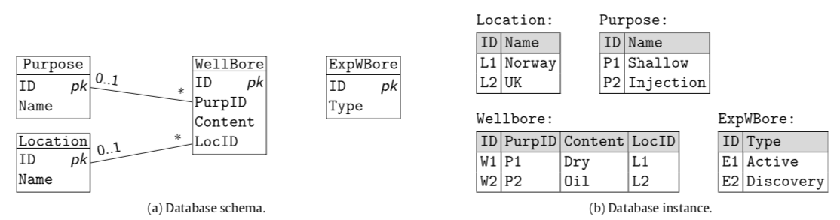
DB schema

Slide 14
Ontology
Classes
Location
Purpose
WellBore
ExplorationWellBore
ShallowWelleBore
Properties
Properties
hasLocation
hasPurpose
hasName
Axioms
ExploratioWellBore ⊑ WellBore
ShallowWelleBore ⊑ WellBore
WellBore ⊑ ∃ hasContent . T

Slide 15
Mappings
"cast" functions
fo: Database entity identifier → URI
fv: Database value → Literal
translation functions
Class(fo(x)) ↦ SQL(x), // fo(x) rdf:type Class
Property(fo(x),fo(y)) ↦ SQL(x,y), // fo(x) Property fo(y)
Property(fo(x),fv(y)) ↦ SQL(x,y), // fo(x) Property fv(y)
SQL(x) and SQL(x, y) are SQL queries with respectively one and two output variables
e.g. 'France' → http://example.com/country/France

Slide 16
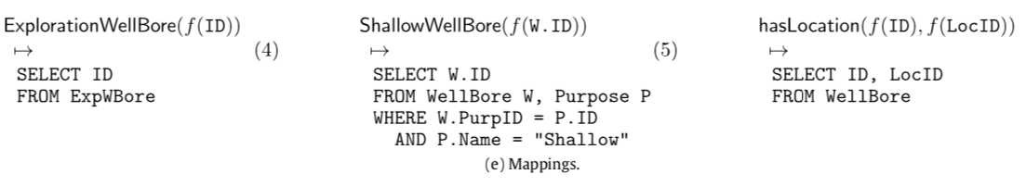
Example
small SQL query compared to SQL code of ETL processes behind access points.
SQL code of individual mappings more readable and more maintainable
can be reused by many data access tasks: they ‘connect’ ontologies to DBs and then can be used for any query over the ontology,

Slide 17
Query answering over ontologies and in OBDA
SELECT ?x WHERE { ?x :hasContent ?y. }
rewritten into a union query s.t. each query of Q′ is subsumed by Q .
compilation of relevant ontological information, similar to the resolution procedure in Prolog. Equivalent to DL-Lite reasoning (*)
SELECT ?x WHERE { ?x hasContent ?y. } UNION { ?x a WellBore. } UNION { ?x a ExplorationWellBore. } UNION { ?x a ShallowWellBore. }
* D. Calvanese, G. De Giacomo, D. Lembo, M. Lenzerini, R. Rosati, Tractable reasoning and efficient query answering in description logics: The DL-Lite family, JAR 39 (3) (2007) 385–429.

Slide 18
unfolding
based on the mappings
SELECT f(ID) AS x FROM ExpWBore
UNION
SELECT f(W.ID) AS x FROM WellBore W, Purpose P
WHERE W.PurpID = P.ID AND P.Name = "Shallow".

Slide 19
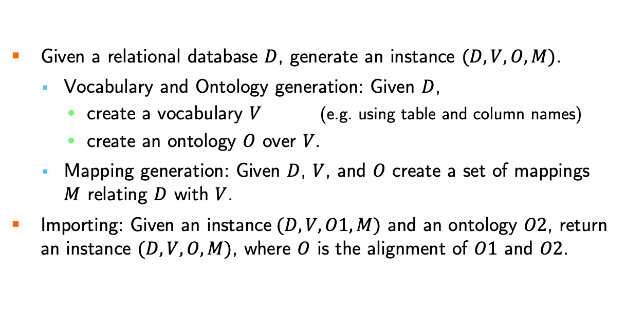
Bootstraping and Importing
Given a relational database $D$, generate an instance $(D,V,O,M)$.
Vocabulary and Ontology generation: Given $D$,
create a vocabulary $V$ (e.g. using table and column names)
create an ontology $O$ over $V$.
Mapping generation: Given $D$, $V$, and $O$ create a set of mappings $M$ relating $D$ with $V$.
Importing: Given an instance$(D,V,O1,M)$ and an ontology $O2$, return an instance $(D, V, O, M)$, where $O$ is the alignment of $O1$ and $O2$.

Slide 20
Bootstrap ontology
Extracted from the relational schemas
mapping rules
mirror RDB schemata by essentially translating
each (non-binary) table into an OWL class;
each attribute not involved in a foreign key into an OWL datatype property;
each foreign key into an OWL object property.

Slide 21
Alignment
Extended version of the ontology alignment system LogMap
derives OWL 2 equivalence and subclass(subproperty) axioms between the terms from O1’s and O2’s vocabularies.
scalable solution that, in the resulting ontology O after O1 and O2 are aligned, minimises the violations of the conservativity principle
O does not entail (many) axioms over O1 ’s and O2 ’s vocabulary which are not already entailed by O1 or O2.

Slide 22
Wall
equivalent
Wall
isIn
equivalent
belongsTo
equivalent
GlassWall
Window
Window ⊑ ∃ belongsTo . Wall
O1
O2
entails
O1: GlassWall ⊑ ∃ isIn . Wall

